Slide 1
Department of Electronics engineering
School of Engineering and Technology
Seminar
On
Wireless body area network
Presented by:-
ANKIT KUMAR VERMA
M.TECH(1ST YEAR)
REG. NO-14304003

Slide 2
CONTENT
INTRODUCTION
HISTORY
HARDWARE
BODY SENSOR
WBAN COMMUNICATION N/W ARCHITECTURE
RADIO TECHNOLOGY
IMPLEMENTATION OF HARDWARE
MAC PROTOCOL
SECURITY REQUIREMENT
APPLICATION
CONCLUSION
REFERENCES

Slide 3
INTRODUCTION
Wireless body area network is an emerging
technology in today world ,it plays an very important role in the field of health services.
Now a days person data monitoring is a leading
issue for health and disease management.
Wireless body area network consist of light-
weight ,ultra low power wearable sensors.
This wearable sensors monitors human physiological activity such as health status.

Slide 4
HISTORY
Wireless body area network was firstly introduced by T. G. Zimmerman in 1996.
Such network was defined as wireless personal area network.
The name body area network was refined as
WBAN by increasing its range more than 3m.

Slide 5
TYPES OF HARDWARE FOR WBAN
Wearable devices used on the body surface.
Medically implanted device inserted inside human body.

Slide 6
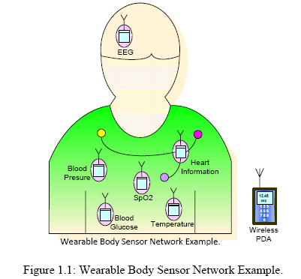

Slide 7
HARDWARE AND DEVICES
BODY SENSOR NODE
PHYSIOLOGICAL SENSOR
RADIO EQUIPMENT
Physiological sensor collects the analog signal that corresponds to physiological activity or human activity.
Analog signal is then transmitted to wired radio equipment where it is digitalized and transmitted to the radio trans receiver.

Slide 8
TOPOLOGY USED BY SENSORS
SENSORS | TOPOLOGY | DATA RATE
Accelerometer/gyroscope | star | high
Blood glucose | star | high
Blood pressure | star | low
CO2 gas sensors | star | Very low
ECG | star | high
EEG | star | high
EMG | star | Very high
Temperature | star | Very low
Video/image | p2p | Very high

Slide 9
WBAN N/W ARCHITECTURE
WBAN architecture is divided into 3 components
1)Tier 1 communication design (intra BAN communication).
2)Tier 2 communication design(inter BAN communication.
3)Tier 3 communication design (beyond BAN communication)

Slide 10
WBAN ARCHITECTURE
INTERBAN
COMMN.
INFRASTUCTURE
BASED ARCHITECTURE
ADHOC BASED ARCHITECTURE
BEYOND BAN
COMMN.
INTRABAN
COMMN.

Slide 11
INTRABAN COMMUNICATION
It refers to the radio communication of around 2m around human body, which is further sub categorized into
Communication between body sensors
Communication between body sensors and
portable personal servers.
Earlier data was transmitted from sensors to personal server through wires

Slide 12
But now sensors are connected to central processor through star topology and from central processor data is transmitted to personal server.
s1
s2
Central processor
Personal server
s3
s4

Slide 13
INTERBAN COMMUNICATION
It is a 2nd tier communication design .In inter BAN communication is from personal severs to one or more access point.
Inter BAN communication is used to interconnect BANS with various network.
Inter BAN communication is divided into 2
categories
1)Infrastructure based architecture
2)Ad hoc based architecture

Slide 14
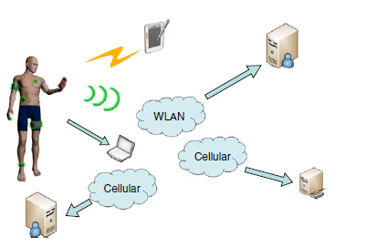
1) Infrastructure based architecture
In infrastructure based communication
environment is assumed with in limited space .
Example- waiting room in hospital, home or office
This architecture use larger bandwidth and use
centralized structure and due to this access paint also works as data base server.

Slide 15
2) Ad hoc based architecture
It consist of multiple access points which helps the body sensor to transmit information to different medical centers.
2 category of node exist in ad hoc based
architecture
1)Sensor node-It is around human body
2) Routing node- it is around WBAN.

Slide 16
BEYOND-BAN COMMUNICATION
Tier 3 communication design is used in metro-polition areas.
To bridge inter-BAN and beyond BAN communication gateway is used and wireless link is created between two networks.
Database is an important component in beyond BAN tier.
Database maintains users profile and medical history.
Through database doctor may access user information as needed.

Slide 17
Beyond BAN communication is application specific and can also be user specific.
If any abnormalities are found in based upon up to date transmitted signal to database an alarm is notified to patient or to the doctor via an email or short message service.
Doctor or other caretaker can contact to the person through videoconferencing /internet and can diagnose the problem.
When an ambulatory person is taken out of hometown might experience critical situation and the emergency personal can retrieve all the necessary information to treat the patient.

Slide 18
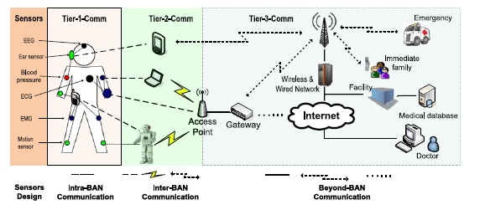
THREE TIER NETWORK ARCHITECTURE OF BAN

Slide 19
RADIO TECHNOLOGY
The radio technology used in WBAN are-
1) Bluetooth(802.15.1)
2) ZIGBEE (802.15.4)
BLUETOOTH-It is used for short range wireless
Communication network .It provides data rate upto 1Mbps.
DRAWBACK-larger power consumption.

Slide 20
2)ZIGBEE-It is low power consumption technology. It has lower data rate from 20kbps
To 250kbps.Zig bee operates in two mode:
Beacon enable mode
Non beacon enable mode

Slide 21
Enable beacon mode uses super frame structure .
Super frame
Inactive portion
Active portion

Slide 22
During inactive mode device may enter a low power mode according to the required application.
Active mode consist of contention access period and contention free period.
Device is communicated during CAP period
and CFP defines time slot where no contention takes place.

Slide 23
IMPLEMENTATION OF WBAN HARDWARE
WBAN which are used for medical purpose uses one of the MICS (medically implanted communication services ) ism band or WMTS (wireless medical telemetry services) or 433MHZ ism bands.
This ism bands is used between central control units and sensor nodes.
Central control unit interfaces with personal server using Bluetooth or Zig bee radio technologies.

Slide 24
SENSOR NODE DESIGN-sensor nodes is designed to collect raw signals of human body. it digitized the signal and transmit through radio trans receiver.
Sensor node consist of A/D convertors , microcontroller ,radio trans receiver and battery. Micro controller is used for data acquisition ,data processing ,power management.
Microcontroller is programmed to turn off the battery connection when it is not functioning i.e in sleep mode.

Slide 25
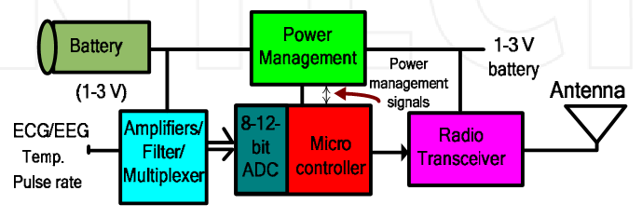
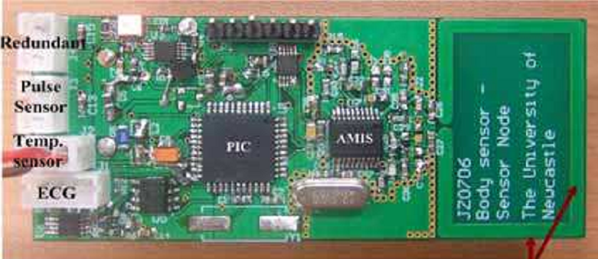

Slide 26
CCU DESIGN-The primary function of CCU is to collect data from sensor node via wireless MICS band link and forward this data to local or remote personal server.
CCU and sensor node consist of AMI52100IC
From AMI semiconductor for 433MHZ MICS and WMTS band generation .
MICS and WMTS band can also be generated
by using CC1010.

Slide 27
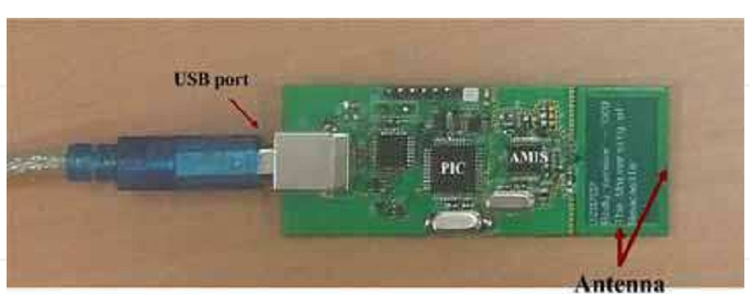
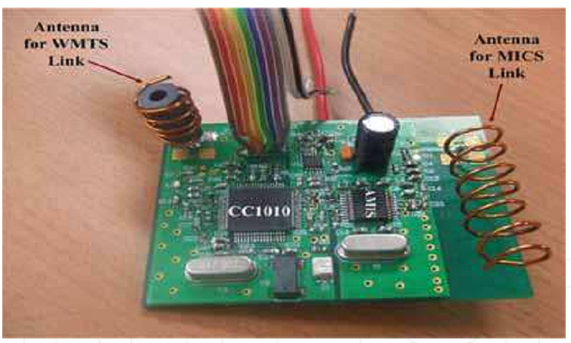
CENTRAL CONTRO UNIT USED INDIVIDUALLY
PORTABLE CCU CONTAINING DUAL TRANSRECEIVER TO SUPPORT TWO DIRECTION WIRELESS LINK

Slide 28
MAC PROTOCOL
SCHEDULED TDMA MAC PROTOCOL
A scheduled MAC protocol provide deterministic delay and no packet loss due to the absence of any transmission channel contention.
TDMA is scheduled multiple access technique
where transmission of packet is done in the form of time slot and frames.
CCU allot time slot to each node to transmit data

Slide 29
TDMA based MAC protocol is suitable for small WBAN network with limit number of sensors generating data at fixed rate.

Slide 30
POLLING BASED MAC PROTOCOL
It is based on scheduled transmission technique.
In this data can be transferred with different rate.
CCU send polling message to all node which in response send either message or NAC indicating no message to send.
An acknowledgement in previous transmission may include pooling message to improve reliability.
New node can be joined by simply sending message to central controller

Slide 31
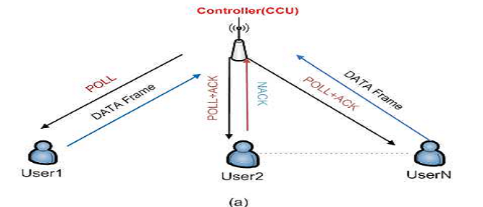
Polling MAC based transmission sequence

Slide 32
RANDOM ACCESS MAC PROTOCOL
It is also called on demand access protocol used for short range communication.
CSMA/CA is a random access protocol used for short range communication.
CSMA/CA protocol based sensor access transmission channel only when it has data in its transmission buffer. If it find channel free then it transmit packets using contention based procedure.

Slide 33
SECURITY REQUIREMENT IN WBAN

Slide 34
SECURITY MECHANISM
TRUST BASED SCHEDULER
KEY MANAGEMENT
SECURED ROUTING PROTOCOL

Slide 35
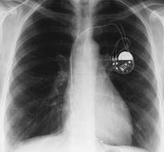
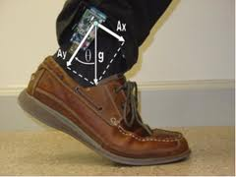
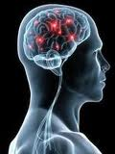
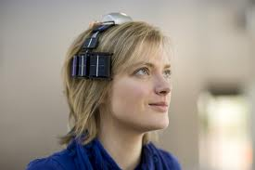
Applications
Medical Heath Care
Sports and Fitness Monitoring
Wireless Audio
Personal Video Devices
Military
Security
Gaming and entertainment

Slide 36
Conclusion
Benefits to patients,medical personnel and society
Continuous monitoring is possible
Early detection of possible problems.
Improving the Quality of Life
Collected the pulse rate, temperature and the location of the patients

Slide 37
Reference
[1] Samaneh Movassaghi, Mehran Abolhasan, Justin Lipman,David Smith, and Abbas Jamalipour, “Wireless Body Area Networks: A Survey” , IEEE Communications surveys & tutorials,vol.16, No.3, Third Quarter,2014
[2] Aashima Arya Naveen Bilandi, “ A Review: Wireless Body Area Networks for Health Care”, International Journal of Innovative Research in Computer and Communication Engineering, Vol.2, Issue 4, April 2014
[3] Prathamesh Dinkar, Abhishek Gulavani, Sourabh Ketkale, Pratik Kadam,and Sheetal Dabhade, “Remote Health Monitoring using Wireless Body Area Network ”, International Journal of Engineering and Advanced Technology (IJEAT) ISSN: 2249 – 8958, Vol.2, Issue-4, April 2013
[ 4] Garth V. Crosby, Tirthankar Ghosh, Renita Murimi and Craig A. Chin, “Wireless Body Area Networks for Healthcare: A Survey ”, International Journal of Ad hoc, Sensor & Ubiquitous Computing (IJASUC) ,Vol.3,No.3 June 2012

Slide 38
[5] Changhong Wang, Qiang Wang, and Shunzhong Shi, “A Distributed Wireless Body Area Network for Medical Supervision”, IEEE International, May 2012
[6] Javed Ahmadand Fareeha Zafar,”Review of Body Area Network Technology & Wireless Medical Monitoring”,International Journal of Information and Communication Technology Research ,Volume 2 No. 2, February 2012
[7] Latre, Benoit, Bart Braem, Ingrid Moerman, Chris Blondia, and Piet Demeester. “A survey on wireless body area networks,” Wireless Networks, vol. 17, 2010
[8] Sana ULLAH,Pervez KHAN,Niamat ULLAH,Shahnaz SALEE and Henry HIGGINSandKyung Sup KWAK, “A Review of Wireless Body Area Networks for Medical Applications ”, Int. J. Communications, Network and System Sciences,Vol.2,november 2009
[9] Pervez Khan, Md.Asdaque Hussain and Kyung Sup Kwak “Medical Applications of Wireless Body Area Networks ”, International Journal of Digital Content Technology and its Applications Vol.3, September 2009

Slide 39
Thank you

