Slide 1
In the name of Allah
Lesson
8
My favorite food
and
My favorite drink
HSM
Winter 93

Slide 2
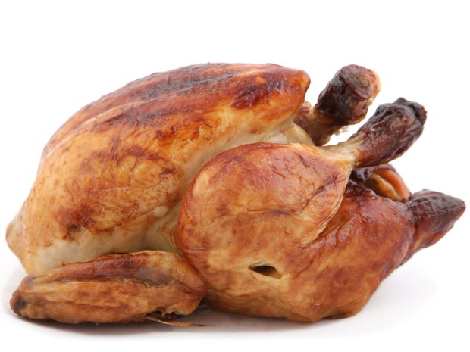
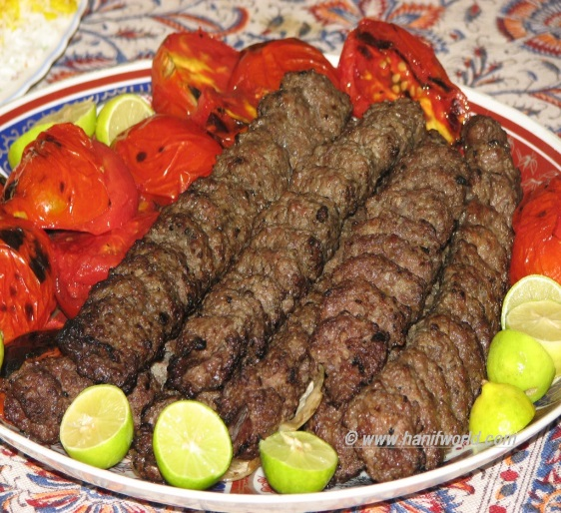
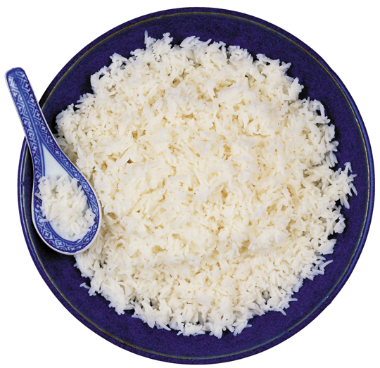
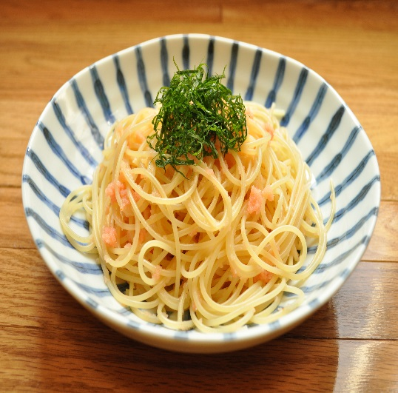
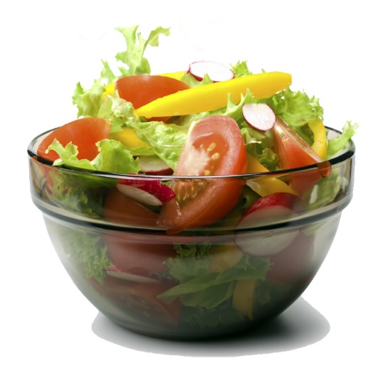
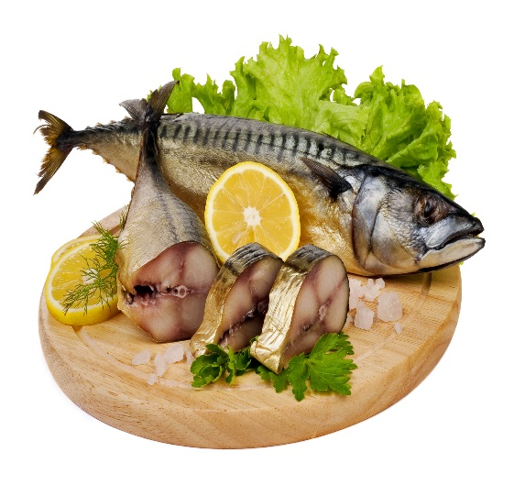
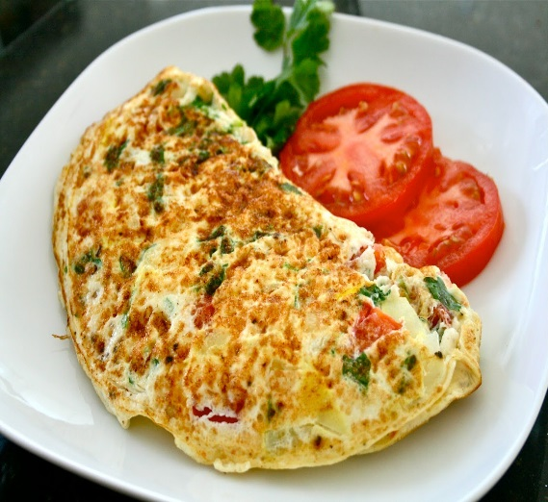
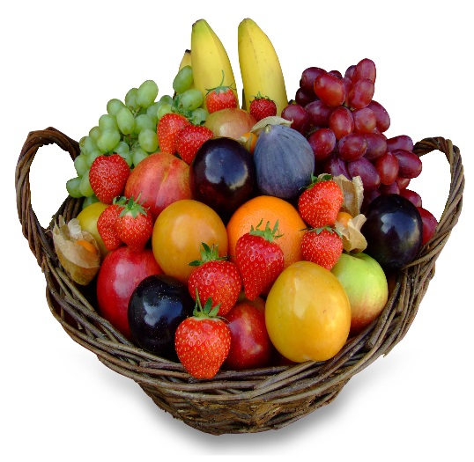
Foods
What’s your favorite food ?
chicken
kebab
rice
spaghetti
salad
fish
omelet
fruits

Slide 3
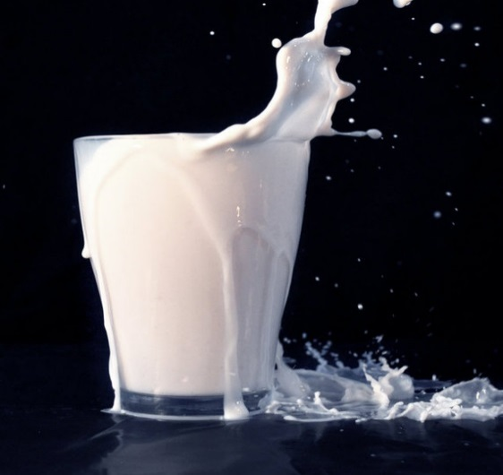
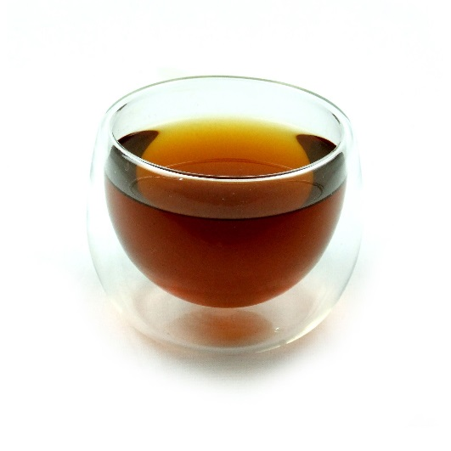
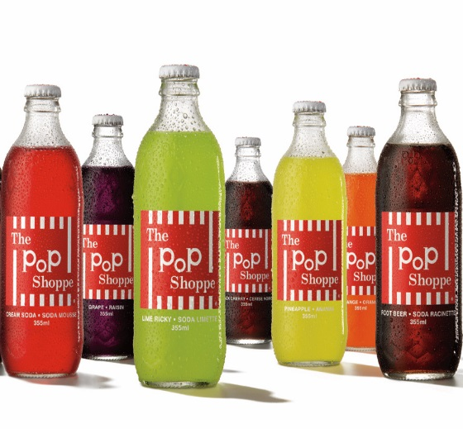
Drinks
What’s your favorite drink ?
orange juice
milk
coffee
tea

Slide 4
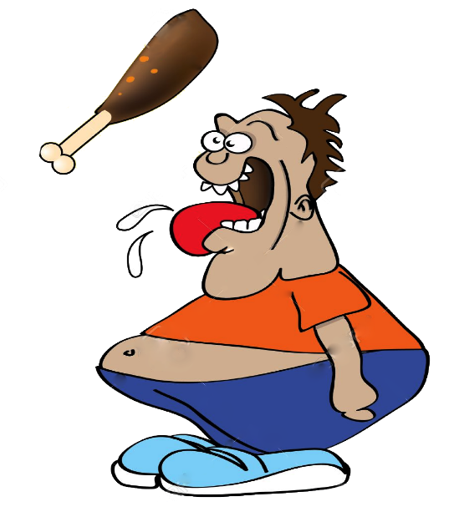
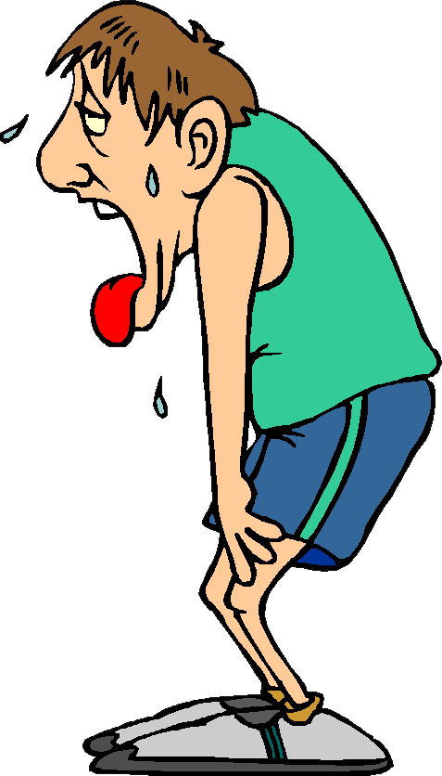
Making Suggestions
I’m hungry.
Let’s have something to eat.
I’m thirsty.
Let’s have something to drink.

Slide 5
The End

