Slide 2
C U D A
ompute
nified
evice
rchitecture
Presented By:
Maryam Haghani
Spring 2013

Slide 3
CUDA & CUDA-Capable Systems

Slide 4
What Is CUDA?
A parallel computing platform and programming model invented by
NVIDIA, introduced In November 2006.
Enables dramatic increases in computing performance by harnessing the power of the graphics processing unit (GPU).
Designed to Support Various Languages and APIs.

Slide 6
CUDA(cont.)
Abstractions provide fine-grained data parallelism and thread parallelism, nested within coarse-grained data parallelism and task parallelism.
Can partition the problem into coarse sub-problems that can be solved independently in parallel by blocks of threads, and each sub-problem into finer pieces that can be solved cooperatively in parallel by all threads within the block.

Slide 7
Goals
Provide a small set of extensions to standard programming languages, like C, that enable a straightforward implementation of parallel algorithms.
With CUDA C/C++, programmers can focus on the task of parallelization of the algorithms rather than spending time on their implementation.

Slide 8
Goals (Cont.)
Support heterogeneous computation where applications use both the CPU and GPU.
- Serial portions of applications are run on the CPU, and parallel portions are offloaded to the GPU.
- The CPU and GPU are treated as separate devices that have their own memory spaces.

Slide 10
When to Use CUDA?
If you're going to move a lot of data and do only a little bit of computation on that data, CUDA or GPU computing probably isn't a great fit for your problem.
Generally, the most successful GPU computing have a high ratio of computation
to communication.

Slide 11
GPUs vs. CPUs
CPU GPU
serial or modestly parallel parts in host C code to run on CPU.
optimize for latency
- Try to minimize the time elapsed of one particular task.
Sophisticated control
well-suited for problems that can be expressed as data-parallel computations
designed such that more transistors
are devoted to data processing rather than data caching and flow control.
optimize for throughput
for more computation being performed per second

Slide 12
The difference between CPU and GPU threads?
GPU threads are extremely lightweight.
GPU threads have almost no creating overhead.
GPU needs more than 1000 threads for full occupancy
- multiple core CPU can execute or create only a little threads.

Slide 13
System Requirements
CUDA-capable GPU.
NVIDIA CUDA Toolkit.
available at :
http://www.nvidia.com/content/cuda/cuda-downloads.html
contains the driver and tools needed to create, build and
run a CUDA application as well as libraries, header files,
CUDA samples source code, and other resources.
An IDE such as Microsoft Visual Studio
2008 or 2010.

Slide 14
Verify Having a CUDA-Capable GPU
Find the vendor name and model of your graphics card.
If it is an NVIDIA card that is listed in the link below, your GPU is CUDA-capable.
http://www.nvidia.com/object/cuda_gpus.html

Slide 15
Compute Capability
The compute capability of a device is defined by a major revision number and a minor revision number.
Devices with the same major revision number are of the same core architecture.
The major revision number is:
- 3 for devices based on the Kepler architecture.
2 for devices based on the Fermi architecture, and
- 1 for devices based on the Tesla architecture.

Slide 16
Compute Capability
The minor revision number corresponds to an incremental improvement to the core architecture, possibly including new features.

Slide 17
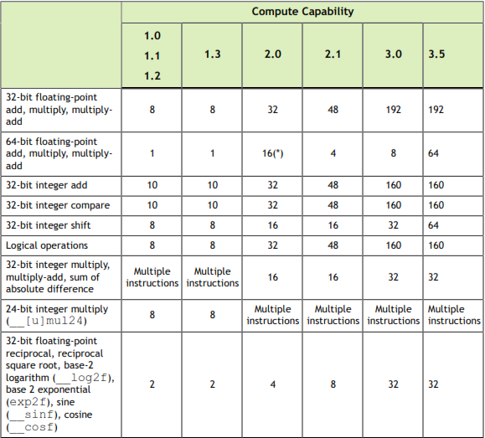
Throughput of Native Arithmetic Instructions
Operations per Clock Cycle per Multiprocessor

Slide 18
CUDA Programming Model

Slide 19
CUDA Thread Hierarchy
GPU can create numerous threads concurrently

Slide 20
CUDA Thread Hierarchy(Cont.)
GPU can create numerous threads concurrently
- all threads are divided into some blocks

Slide 21
CUDA Thread Hierarchy(Cont.)
GPU can create numerous threads concurrently
- all threads are divided into some blocks
- all blocks are grouped into one grid

Slide 22
CUDA Thread Hierarchy(Cont.)
GPU can create numerous threads concurrently
- all threads are divided into some blocks
- all blocks are grouped into one grid

Slide 23
CUDA Thread Hierarchy(Cont.)
GPU can create numerous threads concurrently
- all threads are divided into some blocks
- all blocks are grouped into one grid

Slide 24
CUDA Thread Hierarchy(Cont.)
Each thread identified with a threadIdx
which is a 3-component vector.
so that threads can be identified using a
one-dimensional,
two-dimensional, or
three-dimensional
thread index,
forming a one-dimensional, two-dimensional, or three-dimensional thread block.

Slide 25
CUDA Thread Hierarchy(Cont.)
Blocks are organized into a
one-dimensional,
two-dimensional, or
three-dimensional
grid of thread blocks.
The number of thread blocks in a grid is usually dictated by the size of the data being processed or the number of processors in the system,
which it can greatly exceed.

Slide 26
CUDA Thread Hierarchy(Cont.)
Each block has a maximum number of
threads that it can support.
Newer GPUs can support 1024 threads per block.

Slide 27
CUDA Thread Hierarchy(Cont.)
Identify local and global thread index
- each block has its own local blockID in the same grid.
- each thread has its own local threadID in the same block .
- global thread index is evaluated by blockID and threadID.
block index 0
block index 1
block index 2
0 | 1 | 2 | 3 | 4 | 5 | 6
0 | 1 | 2 | 3 | 4 | 5 | 6
0 | 1 | 2 | 3 | 4 | 5 | 6
0 | 1 | 2 | 3 | 4 | 5 | 6
7 | 8 | 9 | 10 | 11 | 12 | 13
14 | 15 | 16 | 17 | 18 | 19 | 20

Slide 28
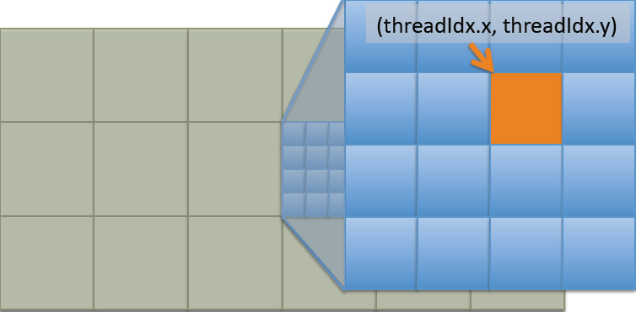
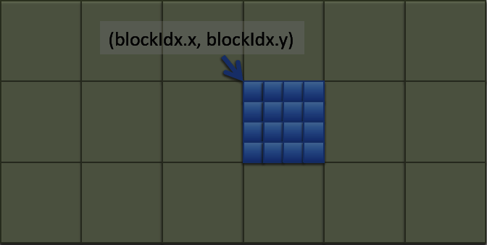
CUDA Thread Hierarchy(Cont.)
CUDA thread hierarchy summary
grid
grid of blocks
grid of blocks of threads

Slide 29
CUDA Transparent Scalability(Cont.)
The same application runs efficiently on new generations of cores.
Thread blocks are required to execute independently.
It must be possible to execute them in any order, in parallel or in series.
This independence requirement allows thread blocks to be scheduled in any order across any number of cores.
29

Slide 30
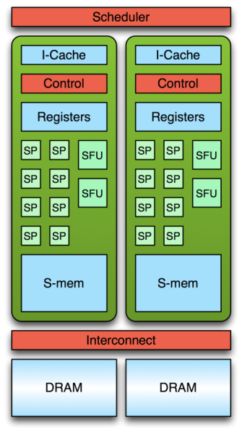
CUDA Transparent Scalability(Cont.)
1
2
3
4
5
6
7
8
9
10
11
12
11
12
9
10
7
8
5
6
3
4
1
2
30

Slide 31
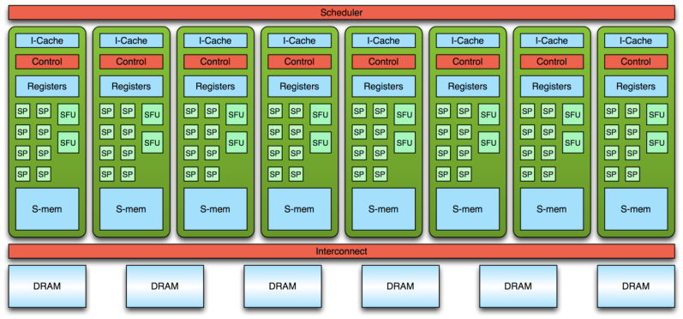
CUDA Transparent Scalability(Cont.)
1
2
3
4
5
6
7
8
9
10
11
12
9
10
11
12
1
2
3
4
5
6
7
8
31

Slide 32
CUDA Transparent Scalability(Cont.)
1
2
3
4
5
6
7
8
9
10
11
12
...
1
2
3
4
5
6
7
8
9
10
11
12

Slide 33
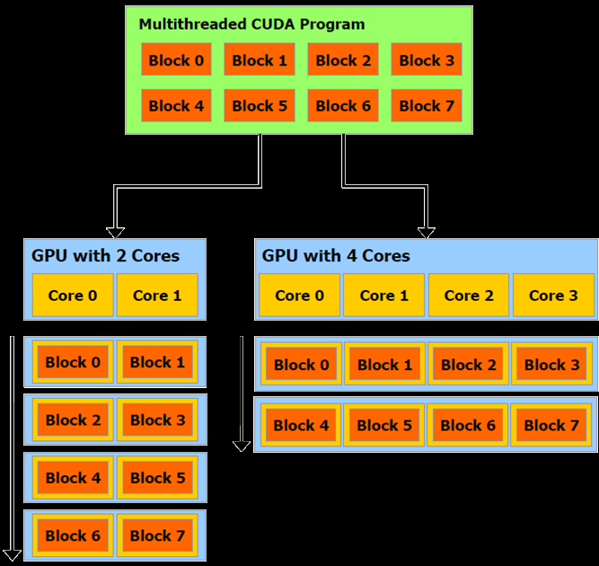
CUDA Transparent Scalability(Cont.)

Slide 34
CUDA Memory Hierarchy
Threads within a block can cooperate by sharing data through some shared memory and by synchronizing their execution to coordinate memory accesses.
can specify synchronization points in the kernel by calling the __syncthreads()
__syncthreads() acts as a barrier at which all threads
in the block must wait before any is allowed to proceed.

Slide 35
CUDA Memory Hierarchy(Cont.)
block of threads
registers
local memory
shared memory

Slide 36
CUDA Memory Hierarchy(Cont.)
grid of blocks
registers
local memory
shared memory

Slide 37
CUDA Memory Hierarchy(Cont.)
grid of blocks
registers
local memory
shared memory
texture memory
constant memory
global memory

Slide 38
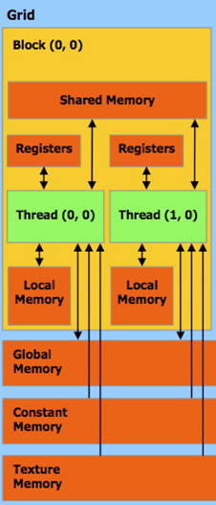
CUDA Memory Hierarchy(Cont.)
Global memory or device memory
- contents are visible between all threads
- communicate between host and device
- readable and writable between all threads
- read/write long memory accessing latency

Slide 39
CUDA Memory Hierarchy(Cont.)
cudaMalloc(…)
- allocate space in the global memory
- require address pointer and space size
cudaFree(…)
- free space in the global memory
- require address pointer to free space

Slide 40
CUDA Memory Hierarchy(Cont.)
cudaMemcpy(…)
- data transfers between host and device
- require source and destination pointer
- require data transfer direction and size
cudaMemcpyHostToHost
cudaMemcpyHostToDevice
cudaMemcpyDeviceToHost
cudaMemcpyDeviceToDevice
Host
40

Slide 41
CUDA Memory Hierarchy(Cont.)
Constant Memory
Read-Only:
Use constant memory when data will not change over the course of a kernel execution.
NVIDIA hardware provides 64KB of constant memory.
Treats differently than standard global memory.
Compute Unified Device architecture
41

Slide 42
CUDA Memory Hierarchy(Cont.)
Constant Memory (Cont.)
Reading from constant memory can conserve memory bandwidth compared to global memory:
Constant memory is cached,
so consecutive reads of the same address will not incur any additional memory traffic.
Compute Unified Device architecture
42

Slide 43
CUDA Memory Hierarchy(Cont.)
Constant Memory (Cont.)
2. NVIDIA hardware can broadcast a single memory read to each half-warp.
GPU will generate only a single read request and subsequently broadcast the data to every thread.
you will generate only 1/16 (roughly 6 percent) of the memory traffic as you would when using global memory.
94 percent reduction in bandwidth
Is actuality a double-edged sword:
Although it can dramatically accelerate performance when all 16 threads are reading the same address, it actually slows performance to a crawl when all 16 threads read different addresses and would probably be slower than using global memory.
Compute Unified Device architecture
43

Slide 44
CUDA Memory Hierarchy(Cont.)
Constant Memory (Cont)
Using Constant Memory:
1. Declare the variable as resides in constant memory:
__constant__ type name
2. Allocate GPU memory :
cudamalloc()
3. Copy from CPU to GPU
cudaMemcpyToSymbol()
4. Copy from GPU to CPU
cudaMemcpy()
5. Deallocate GPU memory
CudaFree()
Compute Unified Device architecture
44

Slide 45
CUDA Memory Hierarchy(Cont.)
Texture Memory
originally designed for traditional graphics applications, classical OpenGL and DirectX rendering pipelines,
Another variety of read-only memory,
Compute Unified Device architecture
45

Slide 46
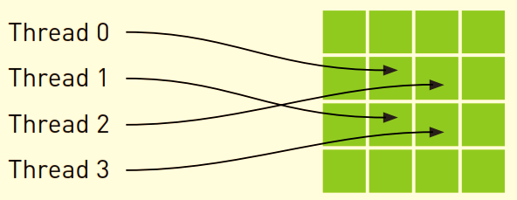
CUDA Memory Hierarchy(Cont.)
Texture Memory (Cont.)
Improve performance & Reduce memory traffic when reads have certain access patterns
spatial locality in the memory access pattern
Non-consecutive
Wouldn’t be cached together in a typical CPU caching scheme.
GPU texture caches designed to accelerate access patterns such as this one
An increase in performance when using texture memory instead of
global memory
Compute Unified Device architecture
46

Slide 47
CUDA Memory Hierarchy(Cont.)
Using Texture Memory:
1. Declare the variable as resides in texture memory:
texture <[type]> name;
2. Allocate GPU memory :
cudamalloc()
3. Bind the reference to the texture buffer:
cudaBindTexture()
4. Finally unbind the reference:
cudaUnbindTexture()
5. Deallocate GPU memory:
cudaFree()
Compute Unified Device architecture
47

Slide 48
Program Work Flow
in
CUDA

Slide 49
1. Allocating memory on the GPU.
cudaMalloc (…)
2. The CPU copies some input data from the CPU to the GPU.
cudaMemcpy (…)
3. The CPU calls some kernels.
Kernel <<< grids of Blocks , Blocks of Threads , SharedMemory>>> ()
4. The CPU copies the results back to the CPU from the GPU.

Slide 50
Kernel
CUDA C extends C by allowing the programmer to define C functions, called kernels.
kernels execute on the GPU.
- all threads execute the same kernel function.
- all threads can take different controlling path
- each thread has its own local ID to control itself

Slide 51
Serial code executes on the host while parallel code executes on the device.

Slide 52
C LANGUAGE EXTENSIONS

Slide 53
Function Type Qualifiers
Function type qualifiers specify whether a function executes on the host or on the device and whether it is callable from the host or from the device.
53

Slide 54
Function Type Qualifiers(Cont.)
__device__
The __device__ qualifier declares a function that is:
‣ Executed on the device,
‣ Callable from the device only.
Restrictions on the device function
- no function pointer
- no recursion function
- no variable number of arguments
- no static variable declares inside the function
54

Slide 55
Function Type Qualifiers(Cont.)
__global__
The __global__ qualifier declares a function as being a kernel. Such a function is:
‣Executed on the device,
‣Callable from the host,
‣Callable from the device for devices of compute capability 3.x
__global__ functions must have void return type.
A call to a __global__ function is asynchronous,
it returns before the device has completed its execution.
55

Slide 56
Function Type Qualifiers(Cont.)
3. __host__
The __host__ qualifier declares a function that is:
‣ Executed on the host,
‣ Callable from the host only.
The default case.
The __global__ and __host__ qualifiers cannot be used together.
The __device__ and __host__ qualifiers can be used together however, in which case the function is compiled for both the host and the device.
56

Slide 57
Variable Type Qualifiers
Variable type qualifiers specify the memory location on the device of a variable.
An automatic variable declared in device code without any of qualifiers generally resides in a register.
in some cases the compiler might choose to place it in local memory.
57

Slide 58
Variable Type Qualifiers(Cont.)
1. __device__
The __device__ qualifier declares a variable that resides on the device.
‣ Resides in global memory space,
‣ Has the lifetime of an application,
‣ Is accessible from all the threads within the grid and from the host through the runtime library (cudaGetSymbolAddress() / cudaGetSymbolSize() / cudaMemcpyToSymbol() / cudaMemcpyFromSymbol()).
58

Slide 59
Variable Type Qualifiers(Cont.)
2. __constant__
The __constant__ qualifier, optionally used together with __device__, declares a variable that:
‣ Resides in constant memory space,
‣ Has the lifetime of an application,
‣ Is accessible from all the threads within the grid and from the host through the runtime library
(cudaGetSymbolAddress() / cudaGetSymbolSize() /
cudaMemcpyToSymbol() / cudaMemcpyFromSymbol()).
59

Slide 60
Variable Type Qualifiers(Cont.)
3. __shared__
The __shared__ qualifier, optionally used together with __device__, declares a variable
that:
‣ Resides in the shared memory space of a thread block,
‣ Has the lifetime of the block,
‣ Is only accessible from all the threads within the block.
60

Slide 61
Built-In Variables
Built-in variables specify the grid and block dimensions and the block and thread indices.
They are only valid within functions that are executed on the device.
gridDim
This variable is of type dim3 and contains the dimensions of the grid.
blockIdx
This variable is of type unit3 and contains the block index within the grid.
blockDim
This variable is of type dim3 and contains the dimensions of the block.
threadIdx
This variable is of type uint3 and contains the thread index within the block.
warpSize
This variable is of type int and contains the warp size in threads.
61

Slide 62
CUDA built-in structures : dim3
an integer vector type based on uint3 that is used to specify dimensions.
When defining a variable of type dim3, any component left unspecified is initialized to 1.
struct dim3
{
int x;
int y;
int z;
}
struct uint3
{
unsigned int x;
unsigned int y;
unsigned int z;
}
62

Slide 63
Vector-Addition Simple Example
//allocate and initialize the host memory space
float *h_A;
float *h_B;
float *h_C;
h_A=(float*)malloc(N*sizeof(float));
h_B=(float*)malloc(N*sizeof(float));
h_C=(float*)malloc(N*sizeof(float));
//allocate the device memory space
float *d_A;
float *d_B;
float *d_C;
cudaMalloc((void**)&d_A,N*sizeof(float));
cudaMalloc((void**)&d_B,N*sizeof(float));
cudaMalloc((void**)&d_C,N*sizeof(float));
//copy raw data from host to device memory
cudaMemcpy(d_A,h_A,N*sizeof(float),cudaMemcpyHostToDevice);
cudaMemcpy(d_B,h_B,N*sizeof(float),cudaMemcpyHostToDevice);
63

Slide 64
Vector-Addition Simple Example(Cont.)
//execute the kernel on N/256 blocks of 256 threads
vectorAddition<<< N/256,256 >>>(d_A,d_B,d_C);
//copy result data from device to host memory
cudaMemcpy(h_C,d_C,N*sizeof(float),cudaMemcpyDeviceToHost);
//free the host memory space
free( h_A );
free( h_B );
free( h_C );
//free the device memory space
cudaFree(d_A);
cudaFree(d_B);
cudaFree(d_C);
64

Slide 65
Vector-Addition Simple Example(Cont.)
//compute vector addition C=A+B
//each thread performs one pair-wise addition
__global__ void vectorAddition( float* d_A, float* d_B, float* d_C )
{
int globalIdx;
//compute the thread global index
globalIdx = blockIdx.x*blockDim.x+threadIdx.x;
//each thread performs its own element addition
d_C[globalIdx] = d_A[globalIdx]+d_B[global_Idx];
return;
}
65

Slide 66
Vector-Addition Simple Example(Cont.)
//compute vector addition C=A+B
//each thread performs one pair-wise addition
__global__ void vectorAddition( float* d_A, float* d_B, float* d_C )
{
int globalIdx;
//compute the thread global index
globalIdx = blockIdx.x * blockDim.x + threadIdx.x;
//each thread performs its own element addition
d_C[globalIdx] = addElement(d_A[globalIdx],d_B[global_Idx]);
return;
}
__device__ float addElement( float input_a, float input_b )
{
return (input_a+input_b);
}
66

Slide 67
Matrix-Addition Simple Example
//allocate and initialize the host memory space
float *h_A;
float *h_B;
float *h_C;
h_A=(float*)malloc(N*N*sizeof(float));
h_B=(float*)malloc(N*N*sizeof(float));
h_C=(float*)malloc(N*N*sizeof(float));
//allocate the device memory space
float *d_A;
float *d_B;
float *d_C;
cudaMalloc((void**)&d_A,N*N*sizeof(float));
cudaMalloc((void**)&d_B,N*N*sizeof(float));
cudaMalloc((void**)&d_C,N*N*sizeof(float));
//copy raw data from host to device memory
cudaMemcpy(d_A,h_A,N*N*sizeof(float),cudaMemcpyHostToDevice);
cudaMemcpy(d_B,h_B,N*N*sizeof(float),cudaMemcpyHostToDevice);
67

Slide 68
Matrix-Addition Simple Example(Cont.)
dim3 gridSize;
dim3 blockSize;
//set the grid size and block size
gridSize.x=N/16; blockSize.x=16;
gridSize.y=N/16; blockSize.y=16;
//execute the kernel on N/256 blocks of 256 threads
matrixAddition<<<gridSize,blockSize>>>(d_A,d_B,d_C);
//copy resukt data from device to host memory
cudaMemcpy(h_C,d_C,N*N*sizeof(float),cudaMemcpyDeviceToHost);
//free the host memory space
free(h_A);
free(h_B);
free(h_C);
//free the device memory space
cudaFree(d_A);
cudaFree(d_B);
cudaFree(d_C);
68

Slide 69
Matrix-Addition Simple Example(Cont.)
//compute matrix addition C=A+B
//each thread performs one pair-wise addition
__global__ void matrixAddition( float* d_A, float* d_B, float* d_C )
{
int msize;
int rowIdx;
int colIdx;
//comput the matrix size
msize = gridDim.x*blockDim.x;
//compute the thread global index
rowIdx = blockIdx.y*blockDim.y+threadIdx.y;
colIdx = blockIdx.x*blockDim.x+threadIdx.x;
//each thread performs its own element addition
d_C[rowIdx*msize+colIdx] =d_A[rowIdx*msize+colIdx]
+d_B[rowIdx*msize+colIdx];
return;
}
69

Slide 70
Check for API Errors
cudaError_t err = cudaMalloc((void **) &d_A,size);
if (err != cudaSuccess)
{
printf (“%s in %s at line %d\n”, cudaGetErrorString(err), __FILE__, __LINE__);
exit(EXIT_FAILURE);
}
70

Slide 71
COMPILATION WITH NVCC
The NVCC compiler translates code written in CUDA into PTX (a pseudo-assembly language).
Just-in-time compilation : Any PTX code loaded by an application at runtime is compiled further to binary code
by the device driver.
Just-in-time compilation increases application load time, but:
allows the application to benefit from any new compiler improvements coming with each new device driver.
It is also the only way for applications to run on devices that did not exist at the time the application was compiled.
71

Slide 72
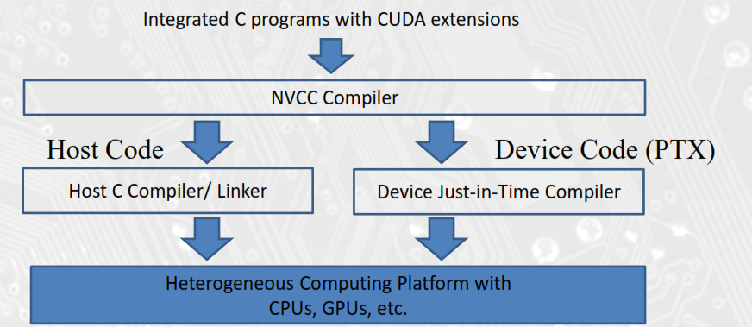

Slide 73
Thanks for Your Attention

