Slide 1
CLOUD COMPUTING
OPEN STACK
COMPUTE NODE
BY- NAMITA,PALAK,SABI

Slide 2
Why switch to Cloud Computing?

Slide 3
An Insight into Cloud Computing
What is Cloud ?
The word cloud is used as a metaphor for "the Internet"
The expression cloud is commonly used in science to describe a large agglomeration of objects that visually appear from a distance as a cloud and describes any set of things
In analogy to above usage the word cloud was used as a metaphor for the Internet and a standardized cloud-like shape was used to denote a network on telephony schematics and later to depict the Internet in computer network diagrams.

Slide 5
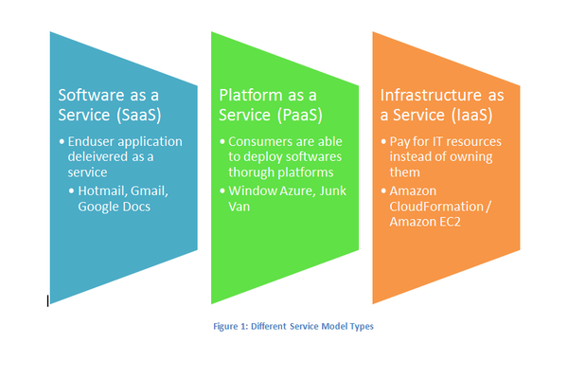
The NIST Models

Slide 6
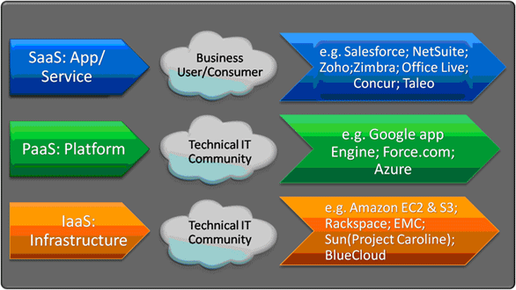
The nist service models

Slide 7
Software as a Service (SaaS)
Defined as service-on-demand, where a provider will license software tailored.
In the SaaS model, cloud providers install and operate application software in the cloud and cloud users access the software from cloud clients. Cloud users do not manage the cloud infrastructure and platform where the application runs. This eliminates the need to install and run the application on the cloud user's own computers, which simplifies maintenance and support.
Examples of SaaS include: Google Apps, Microsoft Office 365.

Slide 8
Platform As A Service (PaaS)
In the PaaS model, cloud providers deliver a computing platform typically including operating system, programming language execution environment, database, and web server. Application developers can develop and run their software solutions on a cloud platform without the cost and complexity of buying and managing the underlying hardware and software layers.
Examples of PaaS include: AWS Elastic Beanstalk, Force.com, Google App Engine, Windows Azure Cloud Services.

Slide 9
Infrastructure As A Service (IaaS)
In the most basic cloud-service model, providers of IaaS offer computers physical or (more often) virtual machines and other resources. IaaS clouds often offer additional resources such as a virtual-machine disk image library, raw (block) and file-based storage, firewalls, load balancers, IP addresses, virtual local area networks (VLANs), and software bundles. IaaS-cloud providers supply these resources on-demand from their large pools installed in data centers.
Examples of IaaS providers include: Amazon EC2, Azure Services Platform, Google Compute Engine, HP Cloud, Oracle Infrastructure as a Service, Rackspace Cloud

Slide 10
The NIST Deployment Models

Slide 11
Types of Cloud
Public Cloud-It allows systems & services to be easily accessible to general public
Private Cloud- It allows systems & services to be easily accessible within an organization
Community Cloud- It allows systems & services to be easily accessible to group of organizations serving the same purpose
Hybrid Cloud-It’s a mixture of public and private cloud.

Slide 12
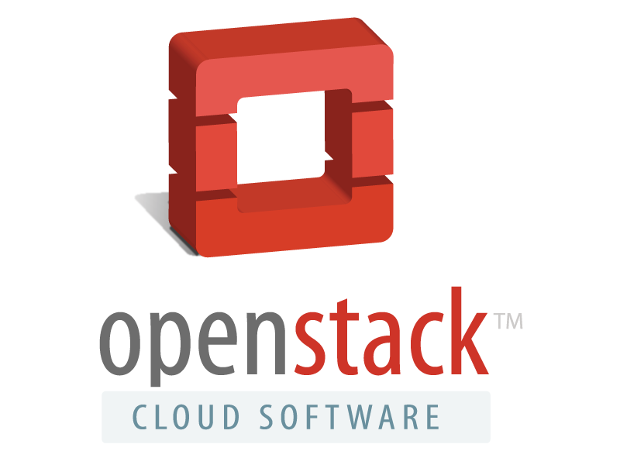
Open Stack
OpenStack is a collection of open source technologies delivering a massively scalable cloud operating system (IaaS).
History
NASA wanted to host its own high-res images without help from Google, Microsoft or Amazon.
Several freethinkers worked with NASA to bring up a distributed computing environment named NASA Nebula.
A key component of that effort was named ‘Nova’
While NASA contributed ‘Nova’, which is processing power, Rackspace contributed ‘swift’, which provided storage capacity.
Nova is similar to Amazon EC2, while swift is similar to Amazon S3
Along with NASA, Rackspace, and a group of freethinkers, Nova emerged into Openstack in July 2010

Slide 13
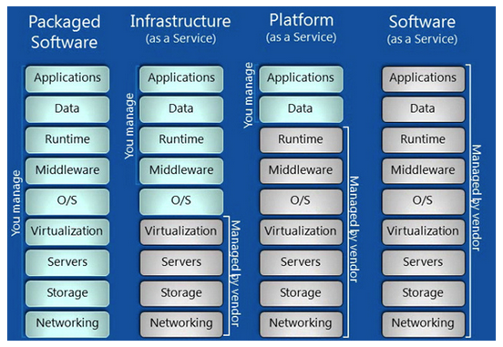
User vs Vendor

Slide 14
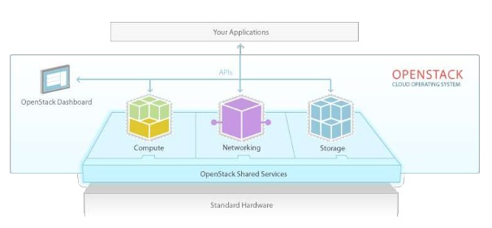
Open Stack Architecture

Slide 15
Components of OpenStack
Project | Codenamed
Dashboard | Horizon
Compute | Nova
Identity | Keystone
Network | Neutron
Image Service | Glance
Block Storage | Cinder
Object Storage | Swift
Metering | Telemetry
Orchestration | Heat

Slide 16
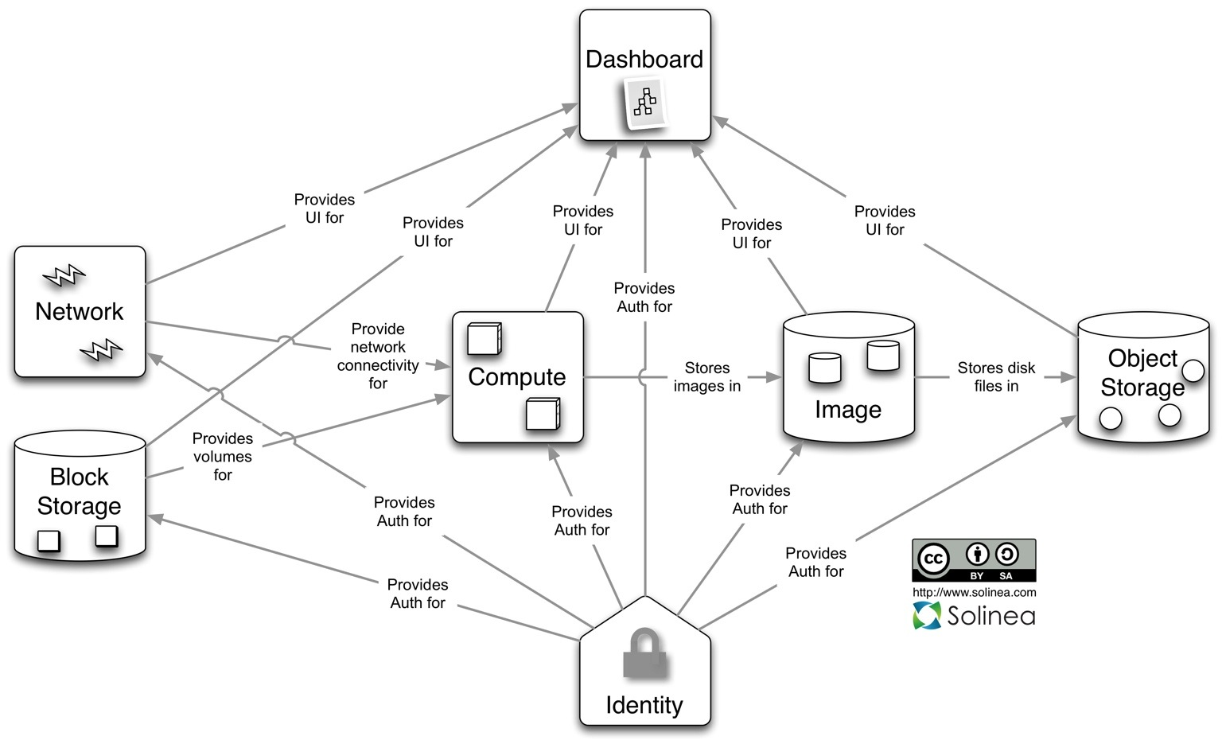
Different Nodes in Open Stack

Slide 17
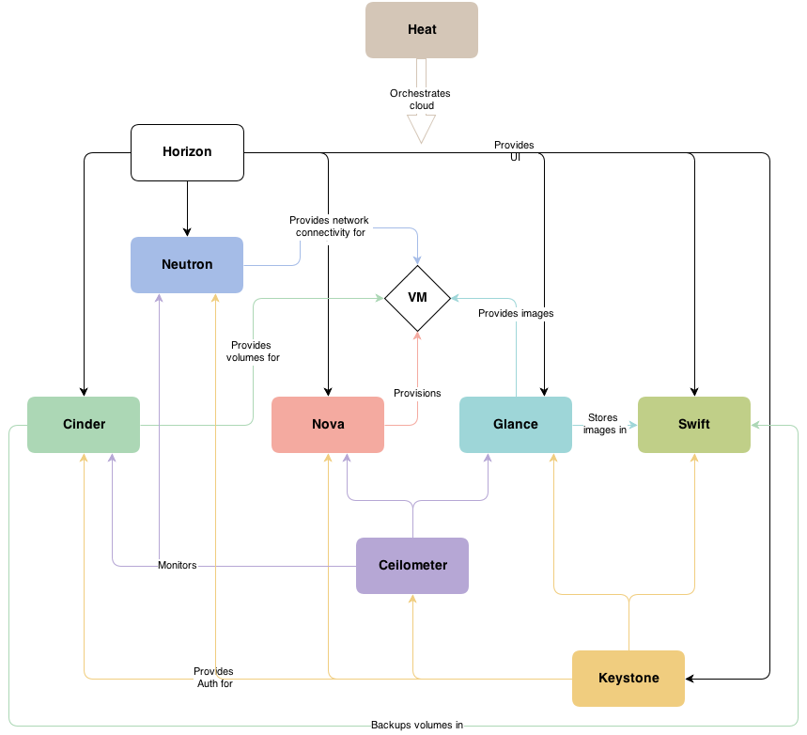
Conceptual Architecture

Slide 18
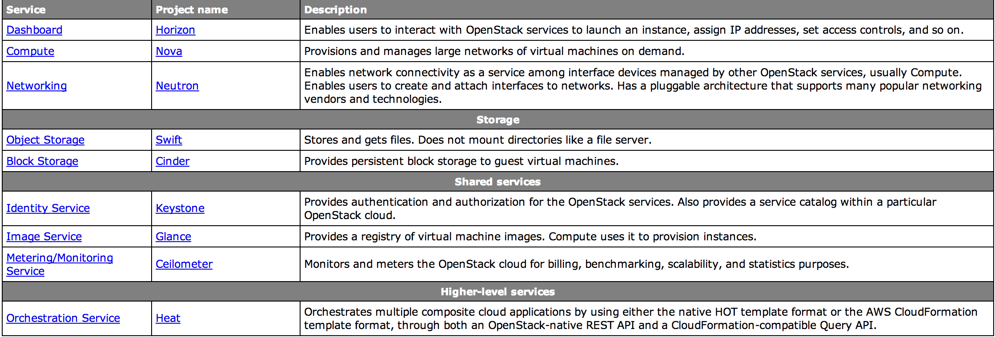
Functions

Slide 19
Nova Compute

Slide 20
Neutron Networking

Slide 21
Swift Object Storage

Slide 22
Cinder Block Storage

Slide 23
Keystone Identity Management

Slide 24
Glance Image Management

Slide 25
Ceilometer Metering and Monitoring

Slide 26
Heat Orchestration

Slide 27
Sample Architecture
Three node-architecture with OpenStack Networking (Neutron)

Slide 28
DEVSTACK
DevStack is an opinionated script to quickly create an OpenStack development environment. It can also be used to demonstrate starting/running OpenStack services and provide examples of using them from a command line.
DevStack's mission is to provide and maintain tools used for the installation of the central OpenStack services from source (git repository master, or specific branches) suitable for development and operational testing. It also demonstrates and documents examples of configuring and running services as well as command line client usage.

Slide 29
INSTALLING DEVSTACK
INSTALL OS- DevStack works on selected versions of operating system. So for successful working of DevStack we installed UBUNTU 14.04 LTS(Long Term Support).
DOWNLOAD DEVSTACK- To download DevStack we need to clone to official website of DevStack using a command terminal:
git clone https://github.com/openstack-dev/devstack.git
DevStack contains a script that installs OpenStack and templates for configuration files.
START THE INSTALL- After successfully downloading DevStack we can easily install DevStack using command:
cd devstack; ./stack.sh

